Slide 1

International Political Economy (IPE) Master’s Program
Faculty of Economics and Political Science
Cairo University

Slide 2
History of the IPE Program
The IPE Programme launched in 2021 at Faculty of Economics and Political Science (FEPS), Cairo University, as an interdisciplinary program in the post graduate level, focusing on the intersection of Economics and Political Science.
Having faculty members from departments of Political Science, Economics, Statistics and Social Computing allows the students the opportunity to chose among diverse optional courses.
In that context, FEPS has started offering the degree of Master in International Political Economy.

Slide 3
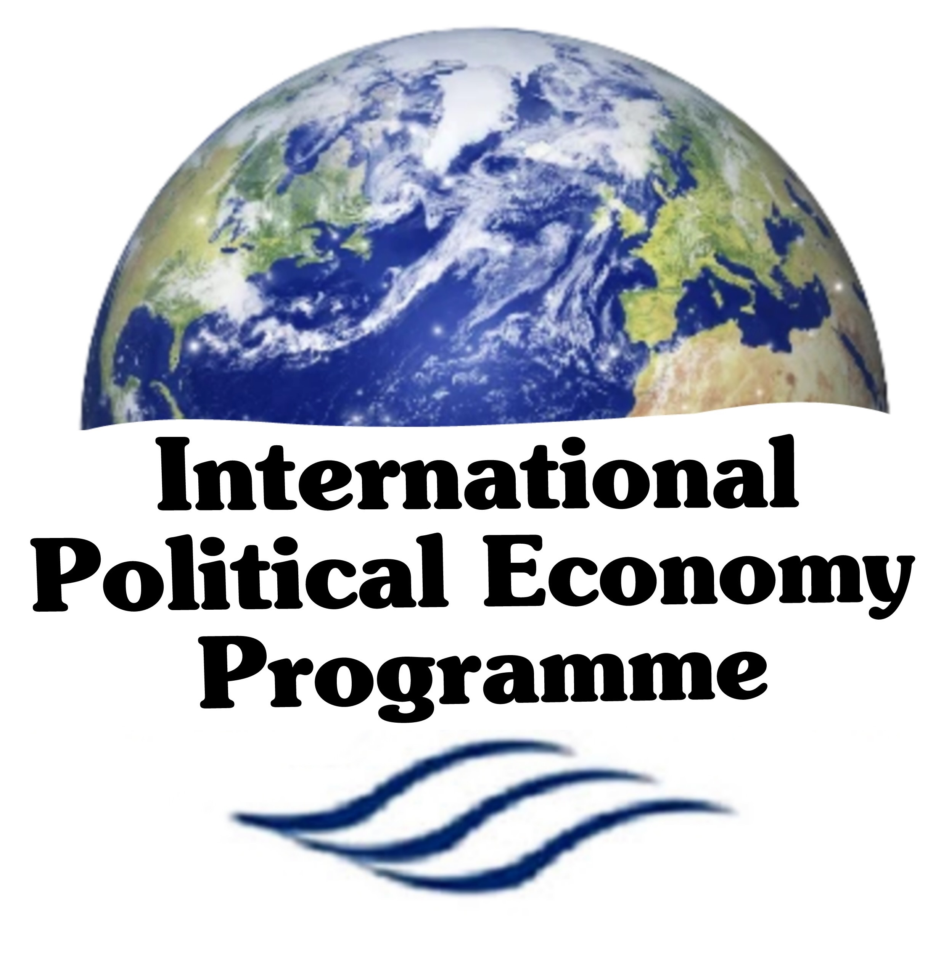
Core Mission
Graduate
highly specialized cadres capable of participating effectively in economic policy-making
EQUIP
Students with knowledge, analytical and quantitative skills to understand challenging issues for economists, diplomats, and international policy makers
Prepare
Highly-skilled political science and economics scholars to work in international organizations, MNCS and think tanks

Slide 4
Objectives
Become a center of excellence for both education and research in the specialized interdisciplinary field of International Political Economy.
Provide an interdisciplinary background on Political Economy issues on local, national and international levels.
Equip postgraduate students with the philosophical, theoretical, practical, and substantive material necessary to acquire an advancing understanding of International Political Economy.
Boost opportunities to conduct research in different issues related to the field study.
Develop researchers' skills in undertaking major research activities and projects in the International Political Economy field of study.
Improve postgraduate students' negotiation skills.
Support Master’s students in acquiring the methodological skills needed to complete a major independent research projects, namely the Master's dissertation.
Graduate new generations of batches who have the knowledge and required skills to deal with important questions of political economy.

Slide 5

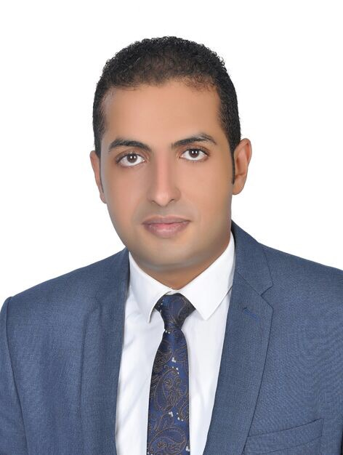
Institutional Structural
Prof. Dr. Taghreed Hassouba
Academic Coordinator of International Political Economy Programme
Ahmed Hamdon
Deputy Academic
Coordinator

Slide 6

Academic Study and Research
The IPE Programme provides interdisciplinary MA degree in International Political Economy.
The study aims at graduating not only practitioners and researchers who will apply the theories and practices that they learn to make their work and agencies more effective, but also graduates who will function as producers of better understanding of the most important political economy questions.
Target Postgraduate Students
The IPE MA programme is designed for calibres that have a strong commitment to intellectual development and desire to pursue their careers in the field of International Political Economy.
Accordingly, the students will conduct research in areas related to international political economy.
As such the programme gives high priority to the time and effort required from students to complete their studies as the main aim of the Programmes is to graduate specialists in International Political Economy.

Slide 7
Academic Study and Research
The International Political Economy MA Programme is taught in English Language, consisting of inseparable and integrated parts:
Successful completion of the entire required course work related to class works and written exam of 9 courses.
Successful completion of the dissertation, which must be written in English language.
  Completion of the degree provides graduates with the background to perform independent research on international Political Economy, including trade and currency conflicts, trade exchange, Standards of Labour, technology transfer, and environment preservation.

Slide 8
Interdisciplinary Academic Courses
Economics
Social
Computing
Statistics
Political Science

Slide 9
Interdisciplinary Academic Courses
Compulsory Courses
1- Political Economy for Development. 2- Public Economics. 3- International Political Economy. 4- International Relations.
13 Elective Courses (Select 4 out of 13 Courses)
1- Macroeconomics. 2- Microeconomics. 3- Global Monetary and Financial Stability 4- Migrants, States and the Human Rights in the Global Economy. 5- Applied Econometrics. 6- International Economic Institutions. 7- Economics and security of natural resources. | 8- Political Economy of Economic Reform 9- Political Economy of Democratization 10- Agent-based computational economics 11- Social Network Analysis. 12- Internet politics. 13- Economic Data Analysis 14- Introduction to Data Science

Slide 10
Admission Requirements
Eligibility Criteria: Minimum grade of Bachelor degree of Political Science, Economics with a GPA of at least 2.7 from one of the faculties recognized by the Supreme Council of Universities. TOEFL exam with a minimum score of 550, or an IELTS certificate with a score of at least 6 from the British Council, or its equivalent from Cairo University, is a condition for enrollment in the Academic Master's Program in International Political Economy. Students with a bachelor's degree in English from recognized universities are exempted from this requirement.
Required Documents: Transcript of grades for the four levels of undergraduate studies. B.Sc. Certificate OR an Equivalent Certificate from High Council of Universities in case of private and foreign universities. The Score of TOEFL's Exam of 550 or IELTS band 6. 4 Photos (4 × 6 size). Birth Certificate. Copy of National ID Military Exemption for males.

